Slide 1
Introduction to Cloud Applications (I) Lecture 2: Application Architecture
© Donald F. Ferguson, 2022

Slide 2

Contents
2 | Introduction to Cloud Applications (I) – Lecture 2: Application Architecture © Donald F. Ferguson, 2022

Slide 3
Contents
Course checkpoint.
Answering Ansys specific questions (1).
Walk through the steps to deploy the application from last week.
VMs and containers – introduction.
Application structure:
Full stacks basics.
Angular application quick overview.
Local architecture.
Deployment architecture I.
Introduction to REST.
Introduction to Database-as-a-Service (DBaaS).
Defer for now.

Slide 4
Course Checkpoint
4 | Introduction to Cloud Applications (I) – Lecture 2: Application Architecture © Donald F. Ferguson, 2022

Slide 5
Course Checkpoint
We are looking at feedback from initial lecture.
Comments in next few slides.
Will be adapting for next lecture.
We are already woefully behind schedule.
We will continue to plug away and make best progress.
There will be follow on courses to cover topics we do not get to.
We have not received a lot of feedback.
We are looking to set up a blog/discussion where I can post more detailed answers/comments on some of the questions.

Slide 6
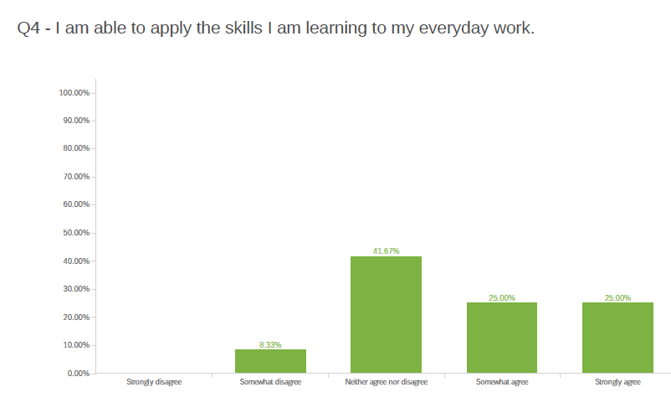
Feedback

Slide 7
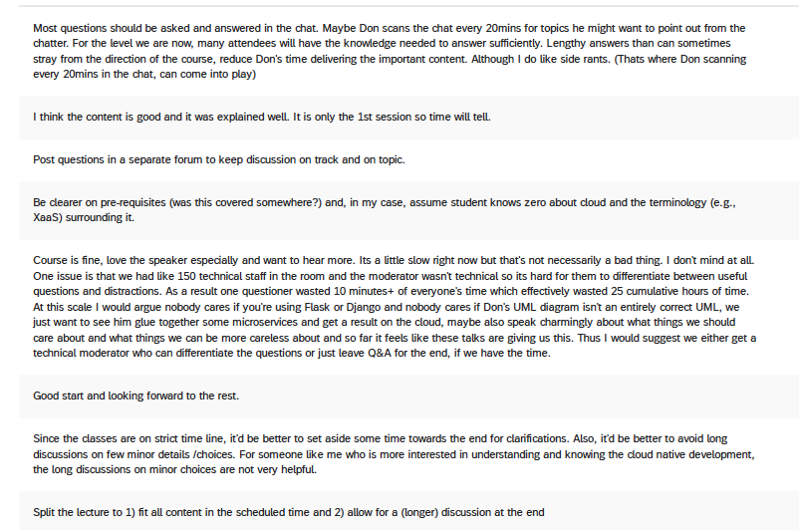
Feedback
Q4 - How can we improve on future sessions related to this particular topic? Please be specific.

Slide 8
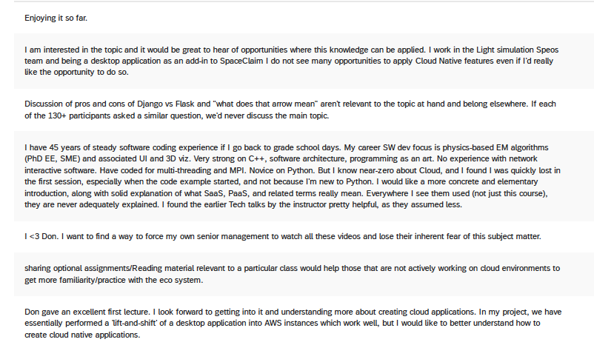
Feedback
Q5 - Please leave any additional feedback on the course.

Slide 9
Ansys Question Switch to confidential presentation strategy-for-class
9 | Introduction to Cloud Applications (I) – Lecture 2: Application Architecture © Donald F. Ferguson, 2022

Slide 10
Initial Deployment (Reshow local execution first)
10 | Introduction to Cloud Applications (I) – Lecture 2: Application Architecture © Donald F. Ferguson, 2022

Slide 11
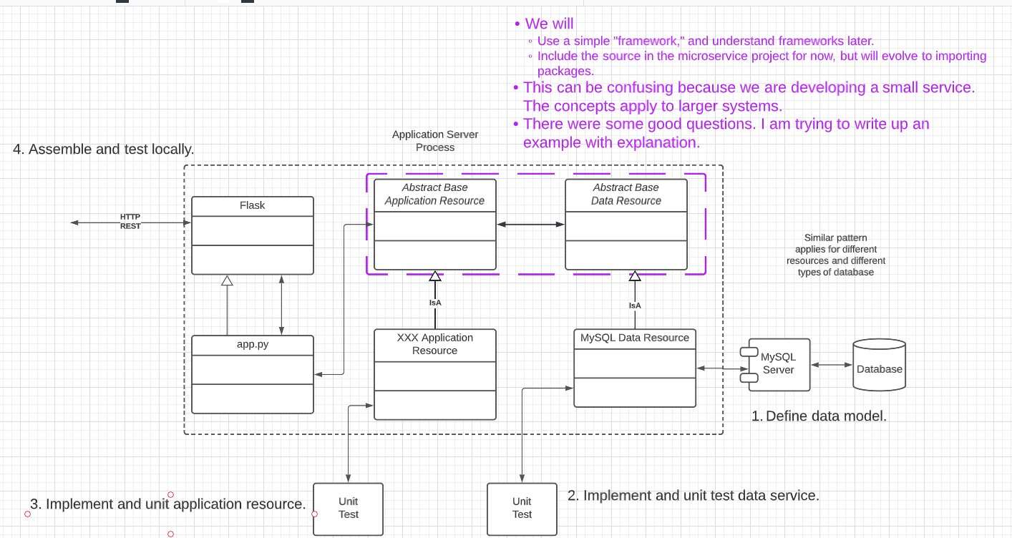
Microservice Project Reminder

Slide 12
IaaS and Deployment
We will do many (most) of these tasks manually with commands or console.
Manual and UI helps visualize what is happening.
Automation and “infrastructure as code” will come later.
Create instance (EC2, Ubuntu) in VPC, security group.
Connect using ssh and key pair (get info from console)
Scroll through some_commands.md, .secret_stuff, app_env.sh
apt install
Mysql (and configure) (https://linuxbeast.com/tutorials/aws/how-to-install-mysql-on-amazon-ec2-ubuntu-18-04/)
Python
Git
Modify mysql bind rules in .cnf to enable remote access.
Deploy code from Git and set up environment.
Test.

Slide 13
Walk Through
https://ansys-aws-console.awsapps.com/start#/

Slide 14
Summary
That as was fun. Let’s not do that again.
All of that was pretty tedious. In future lectures, we will learn:
Infrastructure-as-Code (https://en.wikipedia.org/wiki/Infrastructure_as_code) to enable automation and reuse.
Pipelines to automate tasks when development events occur, e.g. commit.
Higher layers in the cloud stack that make this MUCH simpler.
Containers and Container-as-a-Service
Platform-as-a-Service
We will also start using some more advanced concepts:
Security, secret management.
API management.
Service composition.
... ...

Slide 15
Angular Application
15 | Introduction to Cloud Applications (I) – Lecture 2: Application Architecture © Donald F. Ferguson, 2022

Slide 16
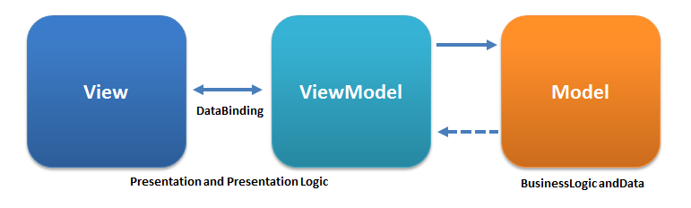
View – Model – View Model
“Model–view–viewmodel (MVVM) is a software architectural pattern that facilitates the separation of the development of the graphical user interface (the view) – be it via a markup language or GUI code – from the development of the business logic or back-end logic (the model) so that the view is not dependent on any specific model platform. The viewmodel of MVVM is a value converter,[1] meaning the viewmodel is responsible for exposing (converting) the data objects from the model in such a way that objects are easily managed and presented ...” https://en.wikipedia.org/wiki/Model%E2%80%93view%E2%80%93viewmodel

Slide 17
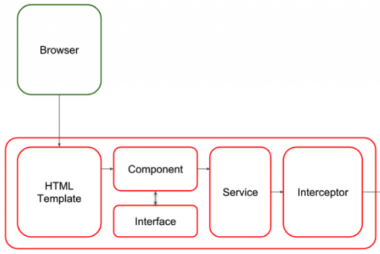
Angular Application Introduction
Overly simplistically, an Angular browser application contains
Main application and component metadata.
A set of (reusable) components, each of which is composed of:
HTML template for rendering.
CSS for styles.
Component implementation.
“Services” for calling APIs to get models.

Slide 18
Overall Structure
API First: All services have a well-defined API.
”The UI” is one of many applications that use the API.
Runtime Container
Application Container
Other UIs.
Other services.
... ...
Binding
Middleware
Application Service
Data Service

Slide 19
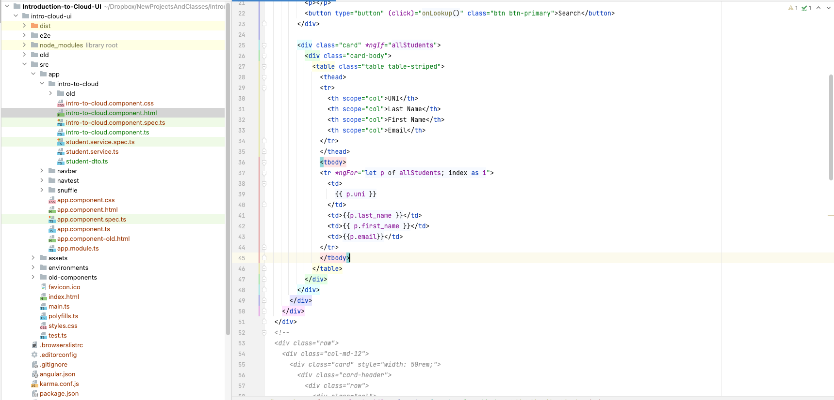
Walkthrough

